Slide 1

Unit - 9 Unix Commands & Shell Script
Operating System (OS)
DU # 2301CS601
Prof. Firoz A. Sherasiya
Computer Engineering Department
firoz.sherasiya@darshan.ac.in
9879879861

Slide 2

Looping
Outline
Commands
Shell Script

Slide 3
cd (Change Directory) Command
The cd command is used to change the current directory (i.e., the directory in which the user is currently working)
Syntax :
cd [-Options] [Directory]
Example :
Option | Use
cd .. | Change Current directory to parent directory
cd ~ | Move to users home directory from anywhere
cd lab_1 | Change from current working directory to lab_1
cd ../downloads | If we are currently in /home/username/documents then we would be placed in /home/username/downloads.

Slide 4
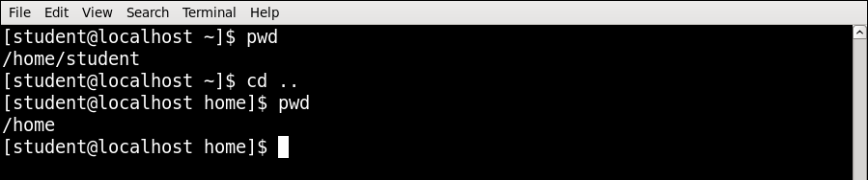
cd Command Example
cd .. | Change Current directory to parent directory

Slide 5
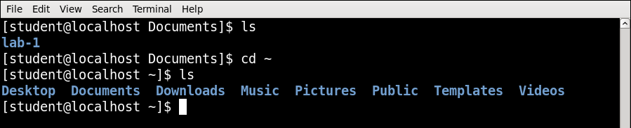
cd Command Example
cd ~ | Move to users home directory from anywhere

Slide 6
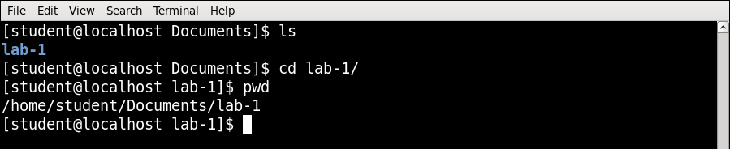
cd Command Example
cd lab_1 | Change from current working directory to lab_1

Slide 7
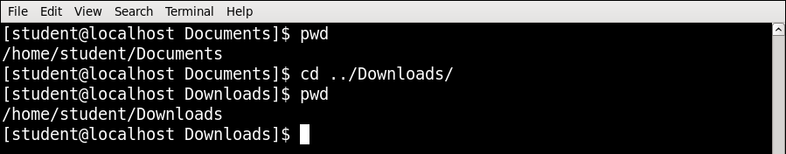
cd Command Example
cd ../downloads | If we are currently in /home/student/documents then we would be placed in /home/student/downloads

Slide 8
ls Command
List directory contents.
Syntax :
ls [Options] [file|dir]
Example :
Option | Use
ls -l | To show long listing information about the file/directory
ls -a | List all files including hidden file starting with '.'
ls -r | List in reverse order
ls -t | Sort by time & date
ls -s | Sort by file size

Slide 9
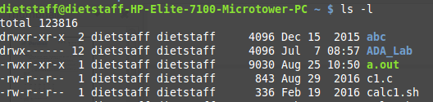
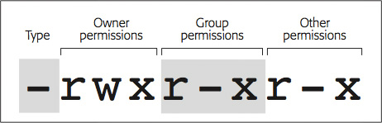
ls Command
Directory & Files
A read, write, execute permissions for user(root), group and others respectively
A number of links for file / dir.
It specifies owner of the file / dir.
It specifies group of the file / dir.
It indicates the file / dir size in bytes.
It specifies the date and time of the last modification of the file.
It specify name of the file / dir.

Slide 10
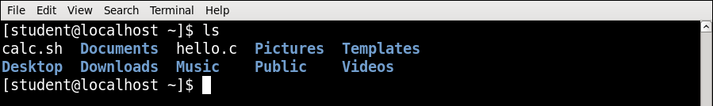
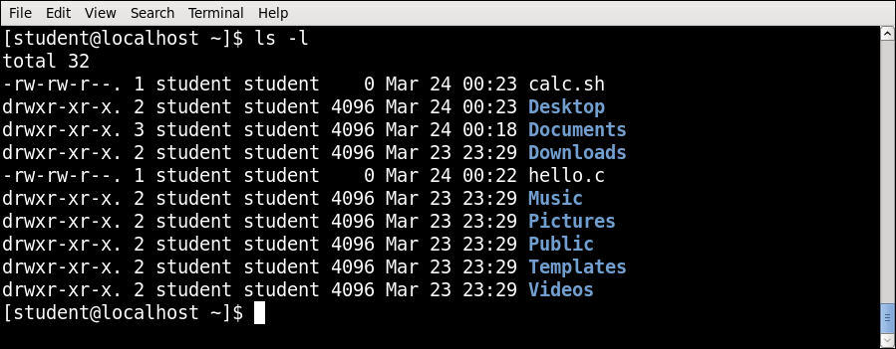
ls Command Example
ls -l | To show long listing information about the file/directory

Slide 11
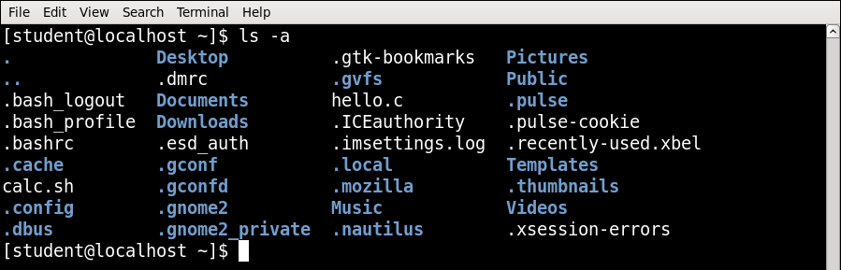
ls Command Example
ls -a | List all files including hidden file starting with '.'

Slide 12
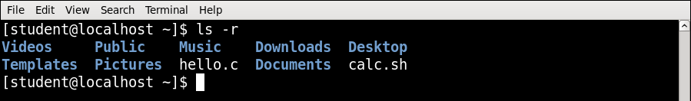
ls Command Example
ls -r | List in reverse order

Slide 13
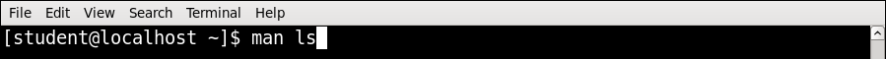
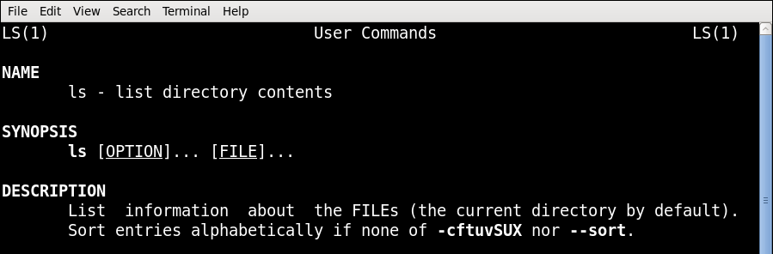
man Command
It is the interface used to view the system's reference manuals.
Syntax :
man [command name]
Example

Slide 14
echo Command
Display a line of text/string on standard output or a file.
Syntax :
echo [option] [string]
Example :
Option | Use
echo -n | Do not output a trailing newline
echo -e | Enable interpretation of backslash escape sequences
Option | Use
\b | It removes all the spaces in between the text
\n | It creates new line from where it is used
\t | It create horizontal tab spaces

Slide 15
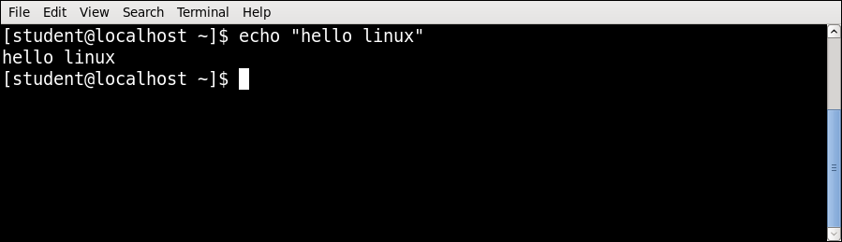
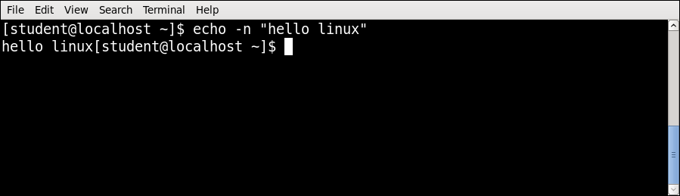
echo Command Example
echo -n | Do not output a trailing newline

Slide 16
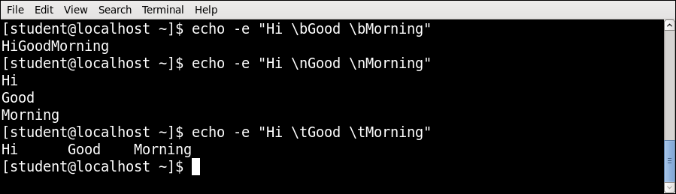
echo Command Example
echo -e | Enable interpretation of backslash escape sequences
\b | It removes all the spaces in between the text
\n | It creates new line from where it is used
\t | It create horizontal tab spaces

Slide 17
cal Command
Displays a simple, formatted calendar in your terminal.
Syntax :
cal [options] [[[day] month] year]
Example :
Option | Use
cal -1 | Display single month output. (This is the default.)
cal -3 | Display three months spanning the date.
cal -s | Display Sunday as the first day of the week.
cal -m | Display Monday as the first day of the week.
cal -j | Use day-of-year numbering for all calendars. These are also called ordinal days. Ordinal days range from 1 to 366.
cal –y | Display a calendar for the whole year

Slide 18
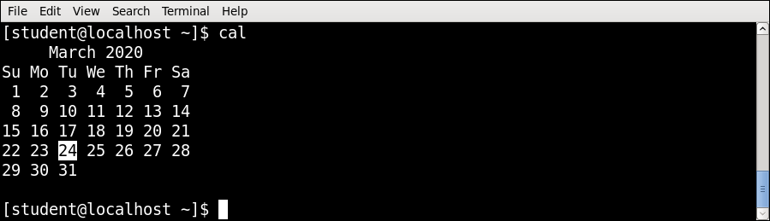
cal Command Example
Cal or cal -1 | Display single month output. (This is the default.)

Slide 19
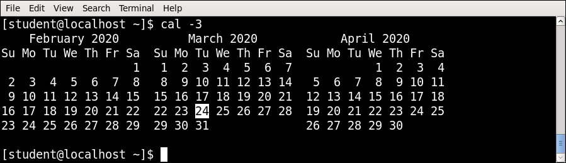
cal Command Example
cal -3 | Display three months spanning the date.

Slide 20

cal Command Example
cal -s | Display Sunday as the first day of the week.

Slide 21
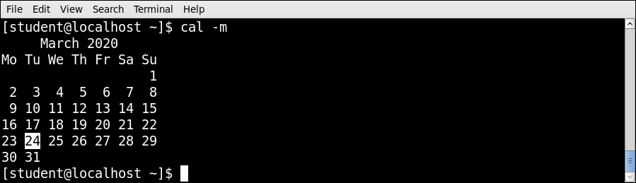
cal Command Example
cal -m | Display Monday as the first day of the week.

Slide 22
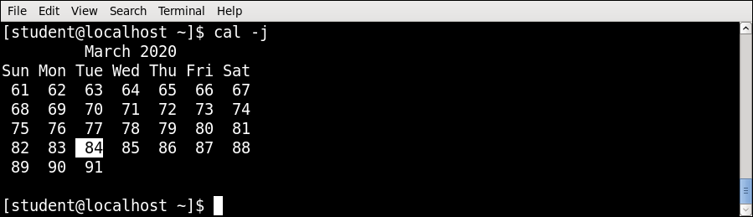
cal Command Example
cal -j | Use day-of-year numbering for all calendars. These are also called ordinal days. Ordinal days range from 1 to 366.

Slide 23
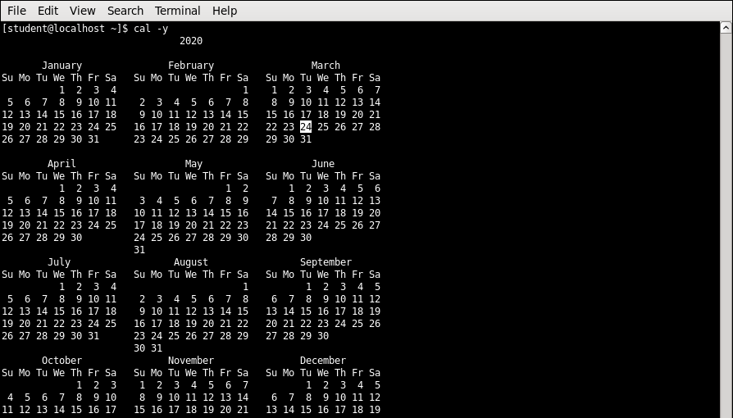
cal Command Example
cal –y | Display a calendar for the whole year

Slide 24
date Command
Print or set the system date and time.
Syntax :
date [OPTION]... [+FORMAT]
Example :
Option | Use
date +%a | The abbreviated weekday name (e.g., Sun)
date +%A | The full weekday name (e.g., Sunday)
date +%b | The abbreviated month name (e.g., Jan)
date +%B | Locale's full month name (e.g., January)
date +%C | The current century; like %Y, except omit last two digits (e.g., 20)
date +%w | day of week (0..6); 0 is Sunday

Slide 25
date Command
Option | Use
date +%d | Display the day of the month
date +%m | Displays the month of year (01 to 12)
date +%y | Displays last two digits of the year(00 to 99)
date +%Y | Display four-digit year.
date +%T | Display the time in 24 hour format as HH:MM:SS
date +%H | Display the hour
date +%M | Display the minute
date +%S | Display the seconds
date +%V | ISO week number, with Monday as first day of week (01..53)
date +%P | locale's equivalent of either AM or PM

Slide 26
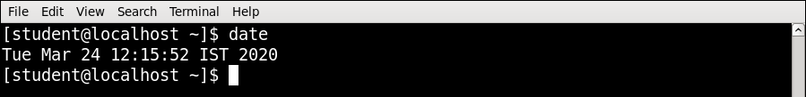
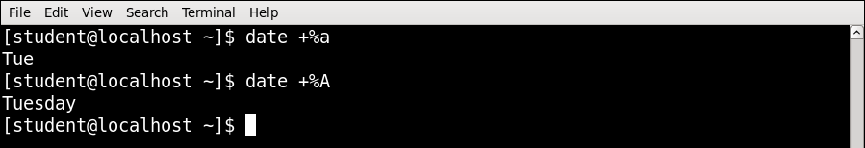
date Command Example
date +%a | The abbreviated weekday name (e.g., Sun)
date +%A | The full weekday name (e.g., Sunday)

Slide 27
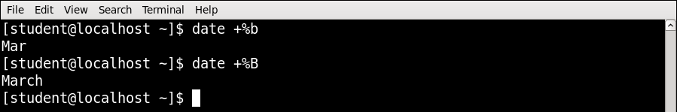
date Command Example
date +%b | The abbreviated month name (e.g., Jan)
date +%B | Locale's full month name (e.g., January)

Slide 28

date Command Example
date +%c | Full date with IST timing
date +%C | The current century; like %Y, except omit last two digits (e.g., 20)

Slide 29
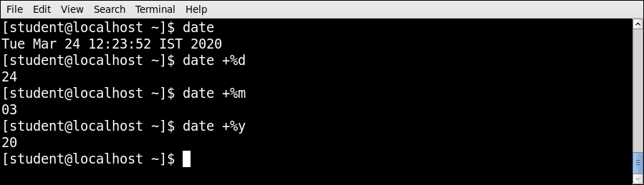
date Command Example
date +%d | Display the day of the month
date +%m | Displays the month of year (01 to 12)
date +%y | Displays last two digits of the year(00 to 99)

Slide 30

date Command Example
date +%y | Displays last two digits of the year(00 to 99)
date +%Y | Display four-digit year.

Slide 31
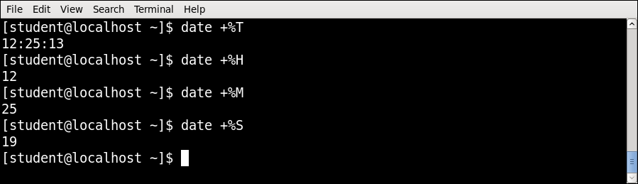
date Command Example
date +%T | Display the time in 24 hour format as HH:MM:SS
date +%H | Display the hour
date +%M | Display the minute
date +%S | Display the seconds

Slide 32
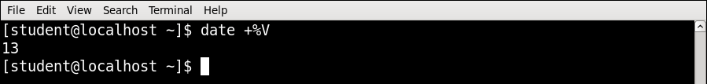
date Command Example
date +%V | ISO week number, with Monday as first day of week (01..53)

Slide 33
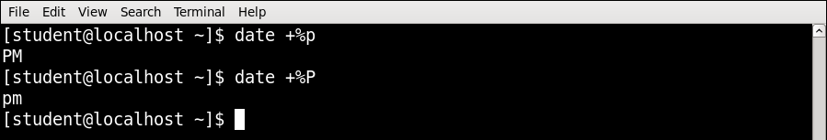
date Command Example
date +%P | locale's equivalent of either AM or PM

Slide 34
clear Command
Clear the terminal screen.
If you take a detailed look after running the clear command, you'll find that it doesn't really clear the terminal. The tool just shifts the text upwards, out of the viewable area.
Syntax :
clear

Slide 35
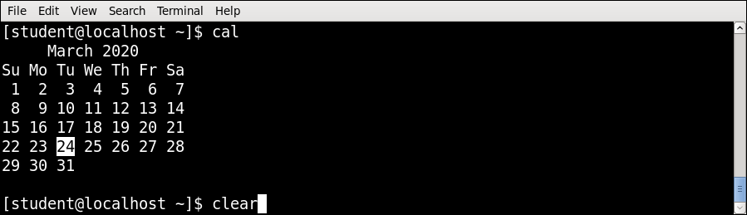
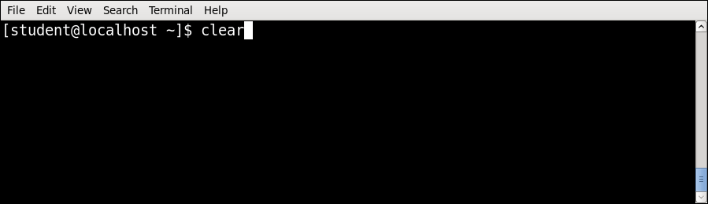
clear Command Example

Slide 36
cat Command
It is used to create, display and concatenate file contents.
Syntax :
cat [OPTION] [FILE]
Example :
Option | Use
cat -b | Omits line numbers for blank space in the output
cat -E | Displays a $ (dollar sign) at the end of each line
cat -n | Line numbers for all the output lines
cat -s | Suppress repeated empty output lines
cat -T | Displays the tab characters as ^I in the output

Slide 37
cat Command
Example :
$ cat > file1.txt
It creates file1.txt and allow us to insert content for this file.
After inserting content, you can use CTRL + C to exit the file.
$cat file.txt > newfile.txt
Read the contents of file.txt and write them to newfile.txt, overwriting anything newfile.txt previously contained. If newfile.txt does not exist, it will be created.
$cat file.txt >> newfile.txt
Read the contents of file.txt and append them to the end of newfile.txt. If newfile.txt does not exist, it will be created.

Slide 38
cat Command
Example :
cat file1.txt file2.txt
It will read the contents of file1.txt and file2.txt and display the result in the terminal.
cat file1.txt file2.txt > combinedfile.txt
It will concatenate the contents of file1.txt and file2.txt and write them to a new file combinedfile.txt using the (>) operator.
If the combinedfile.txt file doesn’t exist, the command will create it. Otherwise, it will overwrite the file.

Slide 39
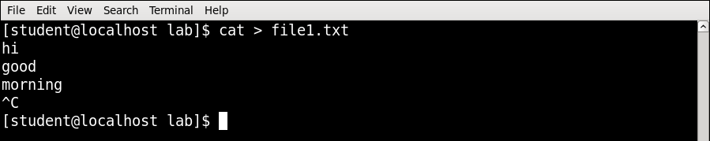
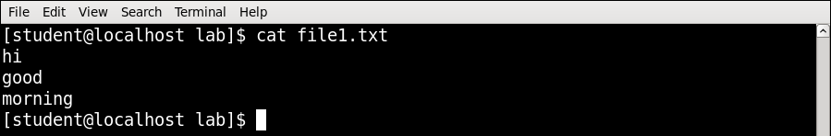
cat Command Example
$ cat > file1.txt
It creates file1.txt and allow us to insert content for this file.
After inserting content, you can use CTRL + C to exit the file.

Slide 40
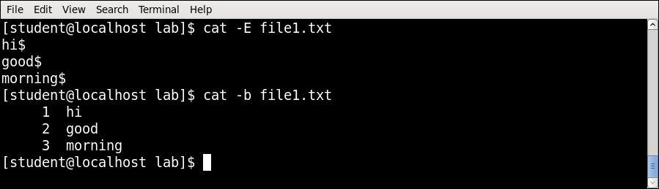
cat Command Example
cat -b | Omits line numbers for blank space in the output
cat -E | Displays a $ (dollar sign) at the end of each line

Slide 41
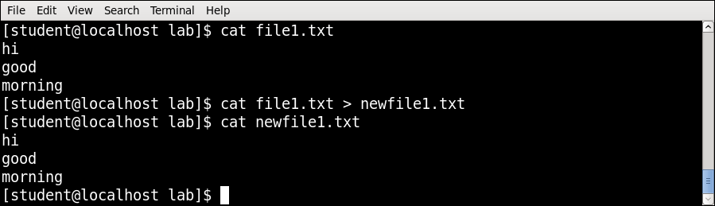
cat Command Example
$cat file.txt > newfile.txt
Read the contents of file.txt and write them to newfile.txt, overwriting anything newfile.txt previously contained.
If newfile.txt does not exist, it will be created.

Slide 42
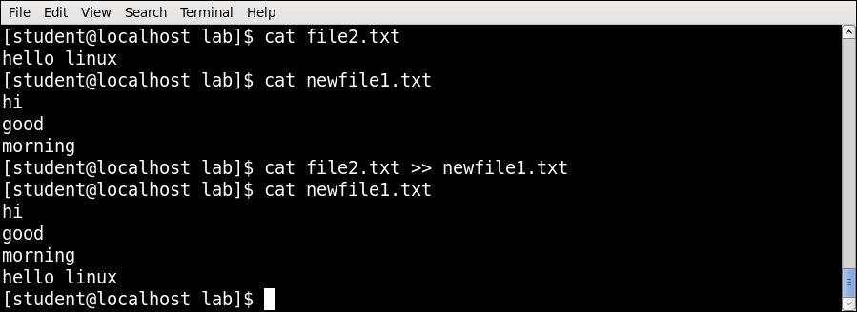
cat Command Example
$cat file.txt >> newfile.txt
Read the contents of file.txt and append them to the end of newfile.txt. If newfile.txt does not exist, it will be created.

Slide 43
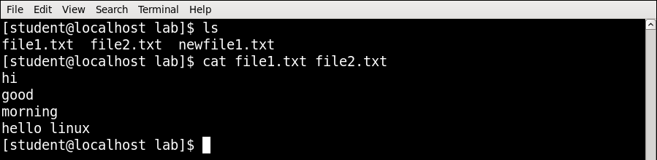
cat Command Example
cat file1.txt file2.txt
It will read the contents of file1.txt and file2.txt and display the result in the terminal.

Slide 44
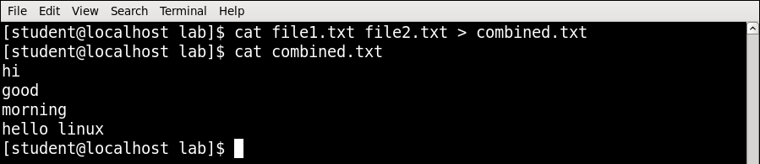
cat Command Example
cat file1.txt file2.txt > combinedfile.txt
It will concatenate the contents of file1.txt and file2.txt and write them to a new file combinedfile.txt using the (>) operator.
If the combinedfile.txt file doesn’t exist, the command will create it otherwise it will overwrite the file.

Slide 45
pwd (Print working directory) Command
It prints the current working directory name with the complete path starting from root (/).
Syntax :
pwd [-OPTION]
Example :

Slide 46
who Command
It display the users that are currently logged into your Unix computer system.
Syntax :
who [-options] [filename]
Example :
Option | Use
who -b | Display the time of the last system boot
who -H | Print a line of column headings
who -q | Displays all login names, and a count of all logged-on users
who -a | Display all details of current logged in user

Slide 47
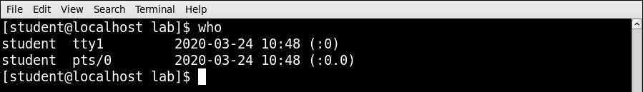
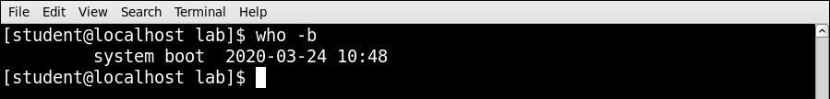
who Command Example
who -b | Display the time of the last system boot

Slide 48
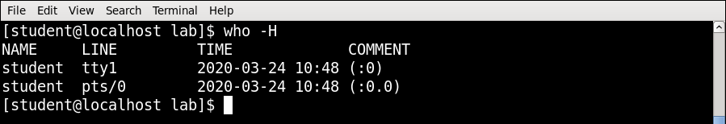
who Command Example
who -H | Print a line of column headings

Slide 49
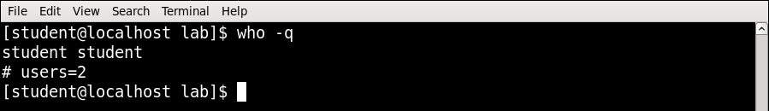
who Command Example
who -q | Displays all login names, and a count of all logged-on users

Slide 50
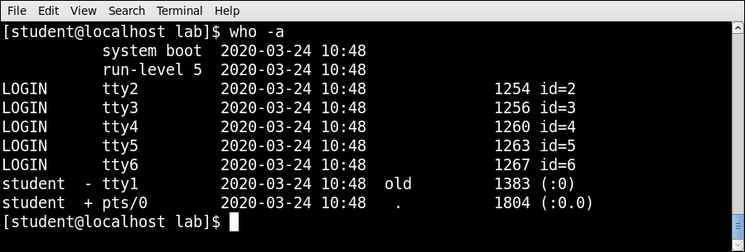
who Command Example
who -a | Display all details of current logged in user

Slide 51
whoami Command
This command prints the username associated with the current effective user ID.
Syntax :
whoami [-OPTION]
Example :
Option | Use
whoami --help | Display a help message, and exit
whoami --version | Display version information, and exit

Slide 52
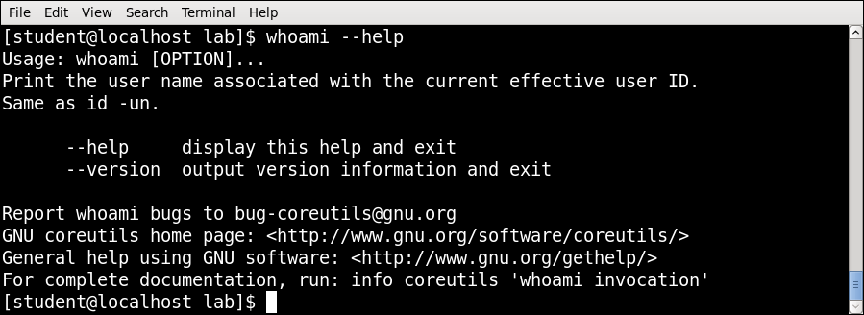
whoami Command Example
whoami --help | Display a help message, and exit

Slide 53
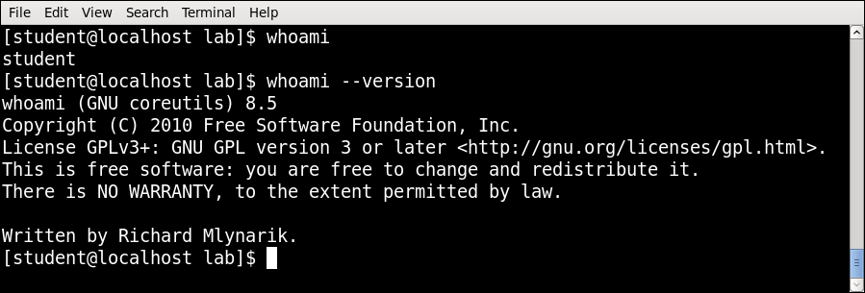
whoami Command Example
whoami --version | Display version information, and exit

Slide 54
uname (unix name) Command
Print information about the current system.
Syntax :
uname [-OPTION]
Example :
Option | Use
uname -s | Print the kernel name
uname -n | Print the network node hostname
uname -v | Print the kernel version
uname -m | Print the machine hardware name
uname -o | Print the operating system

Slide 55
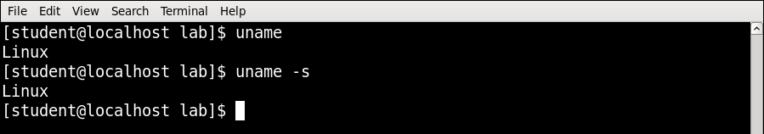
uname Command Example
uname -s | Print the kernel name

Slide 56
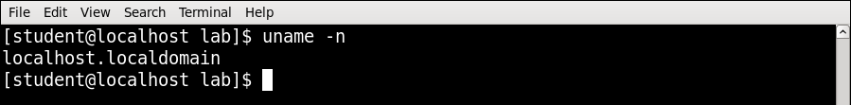
uname Command Example
uname -n | Print the network node hostname

Slide 57
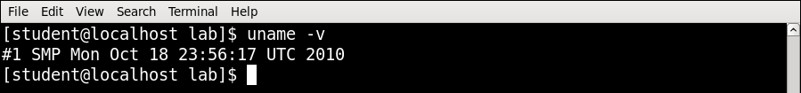
uname Command Example
uname -v | Print the kernel version

Slide 58
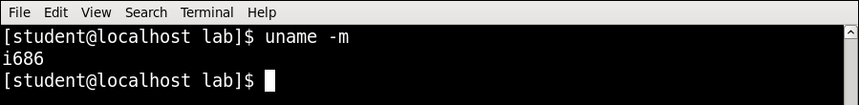
uname Command Example
uname -m | Print the machine hardware name

Slide 59
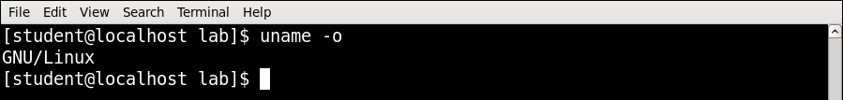
uname Command Example
uname -o | Print the operating system

Slide 60
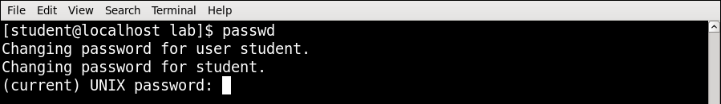
passwd Command
The passwd command is used to change the password of a user account.
Syntax :
passwd [-options] [username]
Example :

Slide 61
mkdir Command
This command is used to make Directories.
Syntax :
mkdir [-OPTION] DIRECTORY
Example :
Option | Use
mkdir -v | Print a message for each created directory
mkdir -p | No error if existing, make parent directories as needed
mkdir -m | To control the permissions of new directories

Slide 62
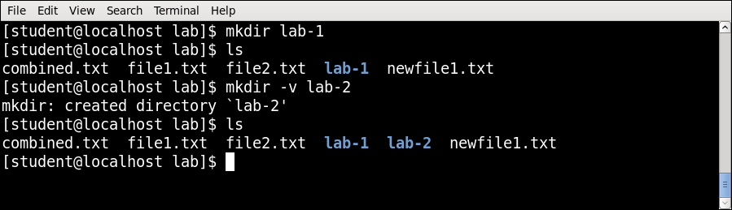
mkdir Command Example
mkdir -v | Print a message for each created directory

Slide 63

mkdir Command Example
mkdir -p | No error if existing, make parent directories as needed

Slide 64

mkdir Command Example
mkdir -m | To control the permissions of new directories

Slide 65
rmdir Command
This command removes empty directories from your filesystem.
Syntax :
rmdir [-OPTION] DIRECTORY
Example :
Option | Use
rmdir -p | Remove directory and its ancestors… e.g., ‘rmdir -p a/b/c’ is similar to ‘rmdir a/b/c a/b a’

Slide 66


rmdir Command Example
rmdir -p | Remove directory and its ancestors… e.g., ‘rmdir -p a/b/c’ is similar to ‘rmdir a/b/c a/b a’

Slide 67
cp(copy) Command
This command is used to copy files and directories.
Syntax :
cp [option] source destination/directory
Example :
Option | Use
cp -i | Interactive - ask before overwrite
cp -f | Force copy by removing the destination file if needed
cp -n | Do not overwrite an existing file
cp -u | Update - copy when source is newer than destination
cp -s | Make symbolic links instead of copying
cp -R | Copy directories recursively
cp -v | Print informative messages

Slide 68

cp Command Example

Slide 69

cp Command Example
cp -i | Interactive - ask before overwrite

Slide 70

cp Command Example
cp -v | Print informative messages

Slide 71

cp Command Example
cp -s | Make symbolic links instead of copying

Slide 72
mv(move) Command
mv command is used to move files and directories.
Syntax :
mv [-options] source dest
Example :
Option | Use
mv -i | Interactive prompt before overwrite
mv -f | Force move by overwriting destination file without prompt
mv -n | Never overwrite any existing file
mv -u | Update - move when source is newer than destination
mv -v | Print informative messages

Slide 73

mv Command Example

Slide 74
rm(remove) Command
The ‘rm’ command is used to delete files and directories.
Syntax :
rm [-OPTION] Filename
Example :
Option | Use
rm -i | Prompt before every removal
rm -d | Delete a empty directory
rm -r | Remove directories and their contents recursively
rm -f | To remove the file forcefully

Slide 75


rm Command Example
rm -i | Prompt before every removal

Slide 76
cut Command
The cut command extracts a given number of characters or columns from a file.
Syntax :
cut [-options] [file]
Example :
Option | Use
cut -c | Select only the characters from each line as specified in LIST
cut -b | Select only the bytes from each line as specified in LIST
cut -f | Cuts the input file using list of field. The default field to be used TAB. The default behavior can be overwritten by use of -d option
cut -d | Specifies a delimiter to by used as a field. Default field is TAB and this option overwrites this default behavior

Slide 77

cut Command Example
cut -c | Select only the characters from each line as specified in LIST

Slide 78
cut Command Example
cut -b | Select only the bytes from each line as specified in LIST

Slide 79

cut Command Example
cut -f | Cuts the input file using list of field. The default field to be used TAB. The default behavior can be overwritten by use of -d option
cut -d | Specifies a delimiter to by used as a field. Default field is TAB and this option overwrites this default behavior

Slide 80
paste Command
The paste command displays the corresponding lines of multiple files side-by-side.
Syntax :
paste [-options] [file]
Example :
Option | Use
paste -d | Reuse characters from LIST instead of tabs
paste -s | Paste one file at a time instead of in parallel

Slide 81

paste Command Example
paste -d | Reuse characters from LIST instead of tabs

Slide 82

paste Command Example
paste -s | Paste one file at a time instead of in parallel

Slide 83
more Command
The more command is a command line utility for viewing the contents of a file or files once screen at a time.
Syntax :
more [-options] [file]
Example :
Option | Use
more -c | Clear screen before displaying
more -number | To Specify how many lines are printed in the screen for a given file
more -s | Doesn’t display extra blank lines

Slide 84

more Command Example

Slide 85


more Command Example
more -number | To Specify how many lines are printed in the screen for a given file

Slide 86


more Command Example
more -c | Clear screen before displaying

Slide 87
cmp Command
cmp command in Linux/UNIX is used to compare the two files byte by byte and helps you to find out whether the two files are identical or not.
If a difference is found, it reports the byte and line number where the first difference is found.
If no differences are found, by default, cmp returns no output.
Syntax :
cmp [OPTION]... FILE1 [FILE2 [SKIP1 [SKIP2]]]

Slide 88

cmp Command Example
Option | Use
cmp -b | Print differing bytes
cmp -i | Skip a particular number of initial bytes from both the files
cmp -s | Do not print anything; only return an exit status indicating whether the files differ
cmp -n | Compare at most LIMIT bytes
cmp -l | Print byte position and byte value for all differing bytes

Slide 89

cmp Command Example
cmp -b | Print differing bytes

Slide 90

cmp Command Example
cmp -i | Skip a particular number of initial bytes from both the files

Slide 91

cmp Command Example
cmp -s | Do not print anything; only return an exit status indicating whether the files differ

Slide 92

cmp Command Example
cmp -n | Compare at most LIMIT bytes

Slide 93

cmp Command Example
cmp -l | Print byte position and byte value for all differing bytes

Slide 94

comm Command
Compare two sorted files line by line.
Syntax :
comm [OPTION]... FILE1 FILE2
Example :

Slide 95

comm Command Example
Option | Use
comm -1 | Suppress column 1 (lines unique to FILE1)
comm -2 | Suppress column 2 (lines unique to FILE2)
comm -3 | Suppress column 3 (lines that appear in both files)

Slide 96
diff(difference) Command
This command is used to display the differences in the files by comparing the files line by line
This command analyzes two files and prints the lines that are different. Essentially, it outputs a set of instructions for how to change one file to make it identical to the second file.
Syntax :
diff [options] File1 File2
Example :
Option | Use
diff -b | Ignores spacing differences
diff -i | Ignores case

Slide 97

diff Command Example
Special symbols are:
a : add
c : change
d : delete

Slide 98
chmod(change mode) Command
chmod is used to change the permissions of files or directories.
Syntax :
chmod [reference][operator][mode] file...
Example :
Reference | Class | Description
u | owner | file's owner
g | group | users who are members of the file's group
o | others | users who are neither the file's owner nor members of the file's group
a | all | All three of the above

Slide 99
chmod(change mode) Command
Operator | Description
+ | Adds the specified modes to the specified classes
- | Removes the specified modes from the specified classes
= | The modes specified are to be made the exact modes for the specified classes
Permission | Description
r | Permission to read the file
w | Permission to write (or delete) the file
x | Permission to execute the file, or, in the case of a directory, search it

Slide 100

chmod Command Example
Each write, read, and execute permissions have following number value:
u | owner
g | group
o | others
a | all
r (read) | 4
w (write) | 2
x (execute) | 1
no permissions | 0

Slide 101

chmod Command Example

Slide 102
chown(change owner) Command
The chown command changes ownership of files and directories in a Linux filesystem.
Syntax :
chown [OPTIONS] USER[:GROUP] FILE(s)

Slide 103

chown Command Example

Slide 104
chgrp(change group) Command
The chgrp command is used to change group ownership of a file/directory.
Syntax :
chgrp [OPTION]… GROUP FILE/DIR…

Slide 105

chgrp Command Example

Slide 106

chgrp Command Example

Slide 107

file Command
The file command is used to determine a file's type.
Syntax :
file [OPTIONS] file1 file2 …
Example :

Slide 108

file Command Example
file -i | To view the mime type of a file rather than the human readable format

Slide 109

finger Command
finger looks up and displays information about system users.
Syntax :
finger [-option] [username]
Example :

Slide 110

finger Command Example
finger -m | Match arguments only on user name (not first or last name)

Slide 111

finger Command Example
finger -l | Force long output format

Slide 112

sleep Command
The sleep command is used to delay for a specified amount of time.
Syntax :
sleep NUMBER[SUFFIX]...
Example :

Slide 113

sleep Command Example
s for seconds; this is a default one if you don’t specify any letter after the integer.
m for minutes.
h for hours.
d for days.

Slide 114
ps Command
Reports a snapshot of the status of currently running processes.
Syntax :
ps [option]
Example :
Option | Use
ps -e | Display every active process on a Linux system in generic (Unix/Linux) format
ps -x | View all processes owned by you
ps -f | To provide more information on processes
ps -u | Filter processes by its user

Slide 115


ps Command Example
ps -e | Display every active process on a Linux system in generic (Unix/Linux) format

Slide 116

ps Command Example
ps -x | View all processes owned by you

Slide 117

ps Command Example
ps -f | To provide more information on processes

Slide 118
kill Command
It is used to terminate processes manually.
kill command sends a signal to a process which terminates the process.
If the user doesn’t specify any signal which is to be sent along with kill command then default TERM signal is sent that terminates the process..
Syntax :
kill [option] PID

Slide 119

kill Command Example

Slide 120

kill Command Example
Kill -l | To display all the available signals

Slide 121
wc Command
It is used to find out number of newline count, word count, byte and characters count in a files specified by the file arguments.
Syntax :
wc [options] filenames
Option | Use
wc -l | Prints the number of lines in a file
wc -w | Prints the number of words in a file
wc -c | Displays the count of bytes in a file
wc -L | Prints only the length of the longest line in a file

Slide 122


wc Command Example
wc -L | Prints only the length of the longest line in a file

Slide 123

wc Command Example
wc -l | Prints the number of lines in a file
wc -w | Prints the number of words in a file
wc -c | Displays the count of bytes in a file

Slide 124
ln Command
ln creates links between files.
ln creates hard links by default, or symbolic links if the -s (--symbolic) option is specified. When creating hard links, each TARGET must exist.
Syntax :
ln [OPTION]… [-T] TARGET LINK_NAME
Option | Use
ln -f | If the destination file or files already exist, overwrite them
ln -i | Prompt the user before overwriting destination files
ln -s | Make symbolic links instead of hard links

Slide 125

ln Command Example

Slide 126

ln Command Example
ln -s | Make symbolic links instead of hard links
f2.txt
(hello good morning)
f6.txt
(hello good morning)

Slide 127
nl Command
nl command numbers the lines in a file.
Syntax :
nl [OPTION]... [FILE]...
Example :
Option | Use
nl -i | Line number increment at each line
nl -s | Add STRING after (possible) line number
nl -w | Use NUMBER columns for line numbers

Slide 128

nl Command Example

Slide 129

nl Command Example
nl -i | Line number increment at each line

Slide 130

nl Command Example
nl -s | Add STRING after (possible) line number

Slide 131

nl Command Example
nl -w | Use NUMBER columns for line numbers

Slide 132
head Command
head makes it easy to output the first part (10 lines by default) of files.
Syntax :
head [OPTION]... [FILE]...
Example :
Option | Use
head -n | Print the first n lines instead of the first 10; with the leading '-', print all but the last n lines of each file
head -c | Print the first n bytes of each file; with a leading '-', print all but the last n bytes of each file
head -q | Never print headers identifying file names

Slide 133

head Command Example

Slide 134

head Command Example
head -n | Print the first n lines instead of the first 10; with the leading '-', print all but the last n lines of each file

Slide 135

head Command Example
head -c | Print the first n bytes of each file; with a leading '-', print all but the last n bytes of each file

Slide 136


head Command Example
head -q | Never print headers identifying file names

Slide 137
tail Command
tail is a command which prints the last few number of lines (10 lines by default) of a certain file, then terminates.
Syntax :
tail [OPTION]... [FILE]...
Option | Use
tail -n | Output the last num lines, instead of the default (10)
tail -c | Output the last num bytes of each file
tail -q | Never output headers

Slide 138

tail Command Example

Slide 139

tail Command Example
tail -n | Output the last num lines, instead of the default (10)

Slide 140

tail Command Example
tail -c | Output the last num bytes of each file

Slide 141
sort Command
sort command is used to sort a file, arranging the records in a particular order.
By default, the sort command sorts file assuming the contents are ASCII. Using options in sort command, it can also be used to sort numerically.
Syntax : sort [OPTION]... [FILE]...
Option | Use
sort -c | To check if the file given is already sorted or not
sort -r | Reverse the result of comparisons
sort -n | Compare according to string numerical value
sort -nr | To sort a file with numeric data in reverse order
sort -k | Sorting a table on the basis of any column
sort -b | Ignore leading blanks

Slide 142

sort Command Example

Slide 143

sort Command Example
sort -c | To check if the file given is already sorted or not

Slide 144

sort Command Example
sort -r | Reverse the result of comparisons

Slide 145

sort Command Example
sort -n | Compare according to string numerical value
sort -nr | To sort a file with numeric data in reverse order

Slide 146

sort Command Example
sort -k | Sorting a table on the basis of any column

Slide 147
find Command
find command searches for files in a directory hierarchy.
Syntax :
find [option] [path...] [expression]
Option | Use
find -name filename | Search for files that are specified by ‘filename’
find -newer filename | Search for files that were modified/created after ‘filename’
find -user name | Search for files owned by user name or ID ‘name’
find -size +N/-N | Search for files of ‘N’ blocks; ‘N’ followed by ‘c’ can be used to measure size in characters
find -empty | Search for empty files and directories
find -perm octal | Search for the file if permission is ‘octal’

Slide 148

find Command Example

Slide 149

find Command Example
find -newer filename | Search for files that were modified/created after ‘filename’

Slide 150

find Command Example
find -user name | Search for files owned by user name or ID ‘name’

Slide 151

find Command Example
find -size +N/-N | Search for files of ‘N’ blocks; ‘N’ followed by ‘c’ can be used to measure size in characters

Slide 152

find Command Example
find -empty | Search for empty files and directories

Slide 153
uniq Command
uniq reports or filters out repeated lines in a file.
It can remove duplicates, show a count of occurrences, show only repeated lines, ignore certain characters and compare on specific fields.
Syntax :
uniq [OPTION]... [INPUT [OUTPUT]]
Option | Use
uniq -u | Prints only unique lines
uniq -d | Only print duplicated lines
uniq -D | Print all duplicate lines
uniq -c | Prefix lines with a number representing how many times they occurred
uniq -i | Ignore case when comparing

Slide 154

uniq Command Example

Slide 155

uniq Command Example
uniq -u | Prints only unique lines

Slide 156

uniq Command Example
uniq -d | Only print duplicated lines

Slide 157
grep Command
The grep filter searches a file for a particular pattern of characters, and displays all lines that contain that pattern.
The pattern that is searched in the file is referred to as the regular expression.
grep stands for globally search for regular expression and print out.
Syntax :
grep [options] pattern [files]
Option | Use
grep -c | Prints only a count of the lines that match a pattern
grep -h | Display the matched lines, but do not display the filenames
grep -l | Displays list of a filenames only
grep -i | Ignores, case for matching

Slide 158

grep Command Example

Slide 159

grep Command Example
grep -c | Prints only a count of the lines that match a pattern
grep -h | Display the matched lines, but do not display the filenames
grep -l | Displays list of a filenames only

Slide 160

grep Command Example
grep -n | Display the matched lines and their line numbers

Slide 161

grep Command Example
grep -v | This prints out all the lines that do not matches the pattern

Slide 162

grep Command Example
grep -w | Match whole word

Slide 163

grep Command Example
grep -o | Print only the matched parts of a matching line

Slide 164

grep Command Example

Slide 165
pipe (|) Command
It redirects the command STDOUT or standard output into the given next command STDIN or standard input.
In short, the output of each process directly as input to the next one like a pipeline.
The symbol '|' denotes a pipe.
Pipes help you mash-up two or more commands at the same time and run them consecutively.
Syntax :
command_1 | command_2 | command_3 | .... | command_N…

Slide 166

pipe Command Example

Slide 167

pipe Command Example

Slide 168

pipe Command Example

Slide 169
tr(translate) Command
The tr command in UNIX is a command line utility for translating or deleting characters.
It supports a range of transformations including uppercase to lowercase, squeezing repeating characters, deleting specific characters and basic find and replace.
It can be used with UNIX pipes to support more complex translation.
tr stands for translate.
Syntax :
tr [OPTION] SET1 [SET2]

Slide 170
tr(translate) Command
POSIX Character set supported by tr command :
[:digit:] Only the digits 0 to 9.
[:alnum:] Any alphanumeric character.
[:alpha:] Any alpha character A to Z or a to z.
[:blank:] Space and TAB characters only.
[:xdigit:] Hexadecimal notation 0-9, A-F, a-f.
[:upper:] Any alpha character A to Z.
[:lower:] Any alpha character a to z..
Option | Use
tr -s | Replaces repeated characters listed in the set1 with single occurrence
tr -d | Delete characters in string1 from the input
tr -c | complements the set of characters in string. i.e., operations apply to characters not in the given set
tr -cd | Remove all characters except digits

Slide 171


tr Command Example

Slide 172

tr Command Example

Slide 173

tr Command Example
tr -s | Replaces repeated characters listed in the set1 with single occurrence

Slide 174

tr Command Example
tr -d | Delete characters in string1 from the input

Slide 175

tr Command Example
tr -c | complements the set of characters in string. i.e., operations apply to characters not in the given set

Slide 176

tr Command Example
tr -cd | Remove all characters except digits

Slide 177

history Command
history command is used to view the previously executed command.
Syntax :
history
Example :

Slide 178


history Command Example

Slide 179
write Command
write sends a message to another user.
Syntax :
write user [ttyname]
Example
Option | Use
user | The user to write to
tty | The specific terminal to write to, if the user is logged in to more than one session

Slide 180

write Command Example
Open first terminal
Open Second terminal then execute command on first terminal.

Slide 181
wall Command
wall send a message to everybody’s terminal.
wall sends a message to everybody logged in with their mesg permission set to yes.
Syntax :
wall [-n] [-t TIMEOUT] [file]
Example
Option | Use
wall -n | --nobanner Suppress banner
wall -t | --timeout TIMEOUT Write timeout to terminals in seconds. TIMEOUT must be positive integer. Default value is 300 seconds, which is a legacy from time when people ran terminals over modem lines.

Slide 182


wall Command Example
Open four different terminal, execute command on first terminal, message will display on everybody’s terminal.

Slide 183
Shell Script

Slide 184
Shell Script
Script is a sequence of commands written as plain text and run by an interpreter (shell).
A shell script is a computer program designed to be run by the Unix/Linux shell which could be one of the following:
The Bourne Shell
The C Shell
The Korn Shell
The GNU Bourne-Again Shell

Slide 185
Shell Script - Cont.…
The prompt, $, which is called the command prompt, is issued by the shell. While the prompt is displayed, you can type a command.
The shell interprets commands the user types and manages their execution.
A shell is a command-line interpreter and typical operations performed by shell scripts include file manipulation, program execution, and printing text.

Slide 186
Steps to write and execute a shell script
Create a file using a vi editor(or any other editor like gedit).
Name script file with extension .sh
Write some code.
Save the script file as filename.sh
For executing the script type bash filename.sh

Slide 187
Shell Variables
The user variable name can be any sequence of letters, digits, and the underscore character, but the first character must be a letter.
To assign a value to a variable:
number=25
name=“abc"
There cannot be any space before or after the “=“
Internally, all values are stored as strings.
To use a variable, precede the name with a “$”.
num=3
a=$num

Slide 188
User input in Shell Script
The read command allows a user to provide the runtime input.
Shell allows to prompt for user input.
Syntax:
read varname [more vars]
Value entered by user is assigned to varname
Run shell script :
bash filename.sh

Slide 189
Operators
Arithmetic Operators
Bash Operator | Operator | Description
+ | + | Addition
- | - | Subtraction
\* | * | Multiplication
/ | / | Division
% | % | Modulus
Assignment Operators
= | = | Assigns right operand in left operand i.e. a=$b

Slide 190
Operators
Relational Operators – for Numeric
Bash Operator | Operator | Description
-eq | == | Equal
-ne | != | Not equal
-gt | > | Greater than
-ge | >= | Greater than or equal
-lt | < | Less than
-le | <= | Less than or equal
-z | == null | Is null

Slide 191
Operators
Relational Operators – for String
Bash Operator | Operator | Description
= or == | == | Equal
!= | != | Not equal
str1 < str2 | < | str1 is less than str2
str1 > str2 | > | str1 is greater str2

Slide 192
Operators
Boolean Operators
Bash Operator | Operator | Description
! | ! | This is logical negation.
-o | OR | This is logical OR.
-a | AND | This is logical AND.
String Operators
Bash Operator | Operator | Description
= | = | Checks if the value of two operands are equal or not
!= | != | If values are not equal then the condition becomes true.

Slide 193
Arithmetic Operator Example (e.g. a=10, b=20)
Operator | Description | Example
+ (Addition) | Adds values on either side of the operator | `expr $a + $b` will give 30
- (Subtraction) | Subtracts right hand operand from left hand operand | `expr $a - $b` will give -10
* (Multiplication) | Multiplies values on either side of the operator | `expr $a \* $b` will give 200
/ (Division) | Divides left hand operand by right hand operand | `expr $b / $a` will give 2
% (Modulus) | Divides left hand operand by right hand operand and returns remainder | `expr $b % $a` will give 0
= (Assignment) | Assigns right operand in left operand | a = $b assign value of b into a
== (Equality) | Compares two numbers, if both are same then returns true. | [ $a == $b ] would return false.
!= (Not Equality) | Compares two numbers, if both are different then returns true. | [ $a != $b ] would return true.

Slide 194
Relational Operator Example (e.g. a=10, b=20)
Operator | Description | Example
-eq | Checks if the value of two operands are equal or not; if yes, then the condition becomes true. | [ $a -eq $b ] is not true.
-ne | Checks if the value of two operands are equal or not; if values are not equal, then the condition becomes true. | [ $a -ne $b ] is true.
-gt | Checks if the value of left operand is greater than the value of right operand; if yes, then the condition becomes true. | [ $a -gt $b ] is not true.
-lt | Checks if the value of left operand is less than the value of right operand; if yes, then the condition becomes true. | [ $a -lt $b ] is true.
-ge | Checks if the value of left operand is greater than or equal to the value of right operand; if yes, then the condition becomes true. | [ $a -ge $b ] is not true.
-le | Checks if the value of left operand is less than or equal to the value of right operand; if yes, then the condition becomes true. | [ $a -le $b ] is true.

Slide 195
Boolean Operator Example (e.g. a=10, b=20)
Operator | Description | Example
! | This is logical negation. This inverts a true condition into false and vice versa. | [ ! false ] is true.
-o | This is logical OR. If one of the operands is true, then the condition becomes true. | [ $a -lt 20 -o $b -gt 100 ] is true.
-a | This is logical AND. If both the operands are true, then the condition becomes true otherwise false. | [ $a -lt 20 -a $b -gt 100 ] is false.

Slide 196
String Operator Example (e.g. a=“abc”, b=“efg”)
Operator | Description | Example
= | Checks if the value of two operands are equal or not; if yes, then the condition becomes true. | [ $a = $b ] is not true.
!= | Checks if the value of two operands are equal or not; if values are not equal then the condition becomes true. | [ $a != $b ] is true.
-z | Checks if the given string operand size is zero; if it is zero length, then it returns true. | [ -z $a ] is not true.
-n | Checks if the given string operand size is non-zero; if it is nonzero length, then it returns true. | [ -n $a ] is not false.
str | Checks if str is not the empty string; if it is empty, then it returns false. | [ $a ] is not false.

Slide 197

expr Command
The expr command in Unix evaluates a given expression and displays its corresponding output.
It is used for:
Basic operations like addition, subtraction, multiplication, division, and modulus on integers.
Evaluating regular expressions, string operations like substring, length of strings etc.
Syntax : expr EXPRESSION
Backtick
num1=10
num2=20
sum=`expr $num1 + $num2`
echo $sum
output: 30
$ expr 3 + 5
output:
8
$ expr 3 \* 5
output:
15

Slide 198
if Statement
If statements use the if, then, else, and fi keywords.
The condition goes in square brackets.
Syntax :
if [ <some test> ] then <commands> fi
if [ $no -gt 100 ]
then
echo "Greater than 100"
fi
The spaces before and after the square brackets
[ ] are required.

Slide 199
if Statement
if [ $a -gt $b ]
then
echo “A is Greater than B"
fi
if [ $a -ne $b ]
then
echo “A is not eqal to B"
fi
if [ `expr $mid1_total + $mid2_total` -gt 50 ]
then
echo “Total Marks is Greater than 50"
fi

Slide 200
if…else Statement
executes statements-1 if condition is true
executes statements-2 if condition is false
if [control command]
then
<statements-1>
else
<statements-2>
fi
if [ $a -eq $b ]
then
echo "a is equal to b"
else
echo "a is not equal to b"
fi

Slide 201
Nested if-else-fi Statement
if [control command]
then
if [control command]
then
<statements>
else
<statements>
fi
else
<statements>
fi

Slide 202
if-else-if ladder
if [control command]
then
<statements>
elif [control command]
then
<statements>
elif [control command]
then
<statements>
else
<statements>
fi
The word elif stands for “else if”
It is part of the if statement and cannot be used by itself

Slide 203
if-else-if ladder Example
if [ $i -eq 5 ]
then
echo "Value of i is 5"
elif [ $i -eq 10 ]
then
echo "Value of i is 10"
elif [ $i -eq 20 ]
then
echo "Value of i is 20"
elif [ $i -eq 30 ]
then
echo "Value of i is 30"
else
echo "Value of i is not equal to 5,10,20 or 30"
fi

Slide 204
case Structure
Use the case statement for a decision that is based on multiple choices.
case $word in
pattern1) c
ommand-list1
;;
pattern2)
command-list2
;;
patternN)
command-listN
;;
*)
;;
esac
echo "Enter number:"
read num
case $num in
1)
echo "It's one!"
;;
2)
echo "It's two!"
;;
3)
echo "It's three!"
;;
*)
echo "It's something else!"
;;
esac

Slide 205

Repetition Constructs

Slide 206
while loop
Syntax:
while [ condition ]
do
command1
command2
…..
.....
done
The while construct tests for a condition, and if true, executes commands.
It keeps looping as long as the condition is true.
i=1
while [ $i -le 10 ]
do
echo “$i”
i=`expr $i + 1`
done

Slide 207
until loop
Syntax:
until [ condition ]
do
command1
command2
…..
.....
done
The until construct tests for a condition, and if false, executes commands.
It keeps looping as long as the condition is false (opposite of while construct)
COUNT=1
until [ $COUNT -gt 5 ];
do
echo "Value of count is: $COUNT"
COUNT=$(($COUNT + 1))
done

Slide 208
for loop using “in” and list of values
Where the value of the variable arg is set to the values provided in the list one at a time and the block of statements executed.
This is repeated until the list is exhausted.
for arg in list
do
command(s)
...
done
for i in 1 2 3 4 5
do
echo "Looping ... number $i"
done

Slide 209
for loop using C like Syntax
for ((initialization; condition test; increment or decrement))
do
//statements to be executed repeatedly
done
for((i=1; i<=5; i++))
do
echo $i
done

Slide 210
select loop
Select command use PS3 variable to print its prompt.
Each word in list is printed on screen preceded by a number.
If the line consists of the number corresponding to one of the displayed words (from the list), then varName is set to that word. You can use if..else.fi or case..in..esac to make a decision.
If the line is empty, WORDS and the prompt are redisplayed.
If EOF (end of file) is read, the command completes.
The loop continues until a break (CTRL+C) is encountered.
select variableName in choice1 choice2 ... choiceN
do
-- Block of Commands –
done

Slide 211
select loop Example
echo "Enter space shuttle to get more information : "
# set shuttle list
select shuttle in Columbia Endeavour Challenger Discovery
do
echo "$shuttle selected"
done
Output:
Enter the space shuttle to get more information :
1) Columbia
2) Endeavor
3) Challenger
4) Discovery
#? 1
Columbia selected
#?

Slide 212
Break and Continue Statement
All statement inside the loop executed as long as some condition are true.
If break placed inside the loop, when loop reach the break statement it will terminated out from the loop.
If continue placed inside the loop, when loop reach the continue statement it will not execute next lines of the loop and it will go to the next iteration.

Slide 213
Break and Continue Statement
break statement
continue statement
while [ condition ]
do
cmd-1
break
cmd-n
done
echo "done"
while [ condition ]
do
cmd-1
continue
cmd-n
done
echo "done"
This iteration is over and there are no more iterations
This iteration is over, do the next iteration

Slide 214






echo and printf Command
echo Command
printf Command
1
2
3
4
5
12345
1
2
3
4
5
12345
1
2
3
4
5
Decimal: 100
Octal: 144
Hex: 64

Slide 215
Average of 4 numbers using bc Command
a=10
b=2
c=12
d=5
sum=$(( a + b + c + d))
avg=`echo $sum / 4 | bc –l`
printf %0.3f “$avg”
OUTPUT :
7.250

Slide 216
Division using bc Command
# get the first number
printf "Enter first integer number: "
read a
# get the second number
printf "Enter second integer number: "
read b
# if b is 0
if [ $b == 0 ]
then
printf "Division by 0 not allowed.\n"
exit # exit the script
fi
# perform division
result=`expr "$a / $b" | bc -l`
printf "%d / %d = %.5f\n" "$a" "$b" "$result"

Slide 217
Operating System (OS)
DU # 2301CS601
Prof. Firoz A. Sherasiya
Computer Engineering Department
firoz.sherasiya@darshan.ac.in
9879879861

